Slide 1
Practices for Data Transparency and Reproducibility
Lars Vilhuber
Cornell University
2020-09-24
The opinions expressed in this talk are solely the authors, and do not represent the views of the U.S. Census Bureau, the American Economic Association, or any of the funding agencies.
© Lars Vilhuber .
Notes:
I am going to
Very briefly describe the background we are coming from
Make note of the various elements of progress (and the broader picture) of open science
Describe some of the ongoing challenges
Provide some guidance based on the lessons learned in the past year

Slide 2
On the menu today
Data provenance: what you want is what you should get
README when you can
The Archive at the End of the Universe: better than your average website
Subplot: When its confidential?

Slide 3

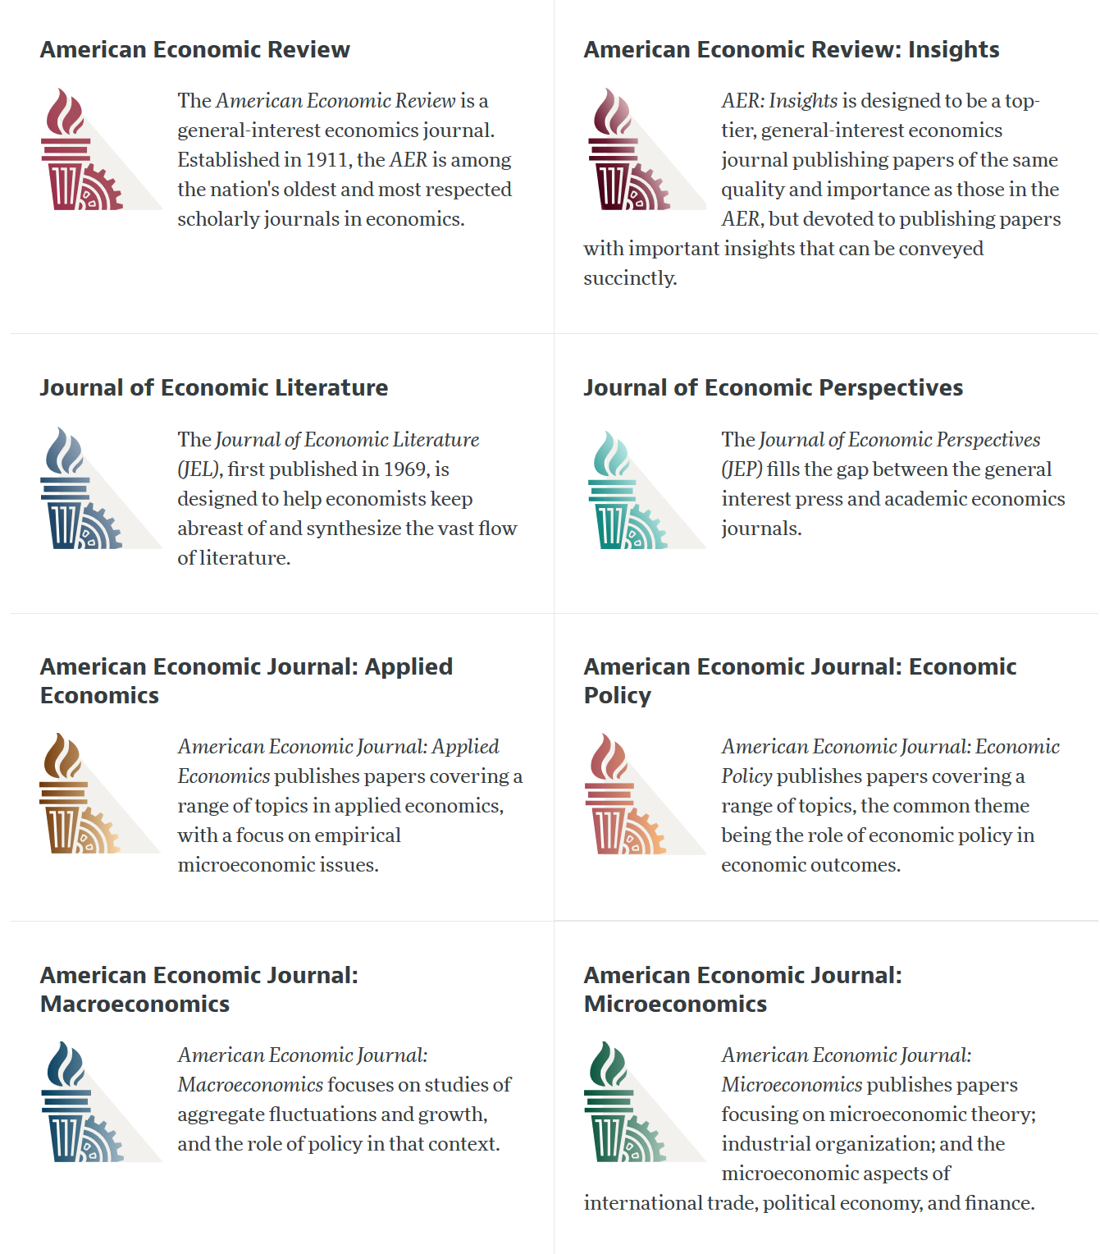

Slide 4
AEA Data & Code Availability Policy (2019)
It is the policy of the American Economic Association to publish papers only if the data used in the analysis are clearly and precisely documented and access to the data and code is clearly and precisely documented and is non-exclusive to the authors.
Authors of accepted papers that contain empirical work, simulations, or experimental work must provide, prior to acceptance, the data, programs, and other details of the computations sufficient to permit replication, as well as information about access to data and programs.

Slide 5
Current efforts at the AEA
Pre-emptively improve code archives
By conducting reproducibility checks when we can
By working with groups that conduct reproducibility checks when we cannot
Better archives
Greater transparency of the code and data archives
Better provenance tracking
Leave code where it is when appropriate
Leave data where it is almost always
Display that information
Notes:
Add logo from AEA

Slide 6

Replication continuum
https://doi.org/10.17226/25303
08
08
08
Reproducibility
Replicability
Generalizability
Narrow Replication (Pesaran 2003)
Pure Replication (Hamermesh 2007)
Verification (Clemens 2015)
Wide Replication (Pesaran 2003)
Statistical Replication (Hamermesh 2007)
Reproduction/Reanalysis (Clemens 2015)
Wider Replication (Pesaran 2003)
Scientific Replication (Hamermesh 2007)
Reanalysis/Robustness (Clemens 2015)

Slide 7
Replication continuum
Same data | Same code | Same methods | Same context
08
Reproducibility
Narrow Replication (Pesaran 2003)
Pure Replication (Hamermesh 2007)
Verification (Clemens 2015)

Slide 8
Data provenance

Slide 9
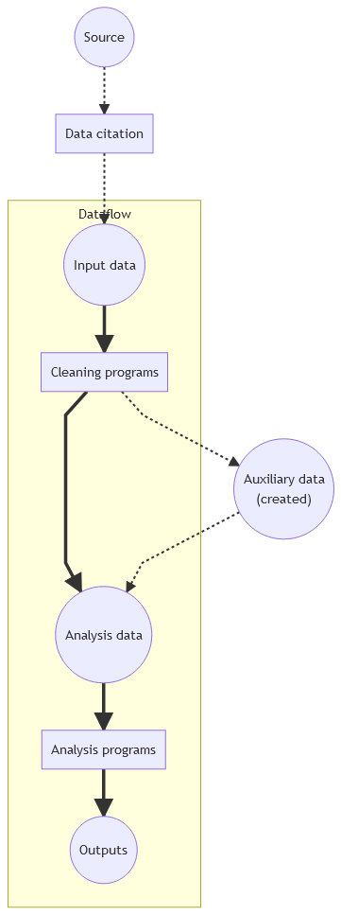
Simplified model
Basic data-oriented flow
Historically: analysis data
More recently: input data, too
But where does it come from? (“provenance”)

Slide 10
Poor citation practices
Macrodata:
“We use data downloaded from the Bureau of Economic Analysis…”
Microdata:
“… this paper uses data from the Current Population Survey…”

Slide 11
An analogy…

Slide 12

Would you buy a car from this guy?

Slide 13
Provenance!
Does the sales person have a good record?
Where does the car come from?
What do we know about the car?

Slide 14
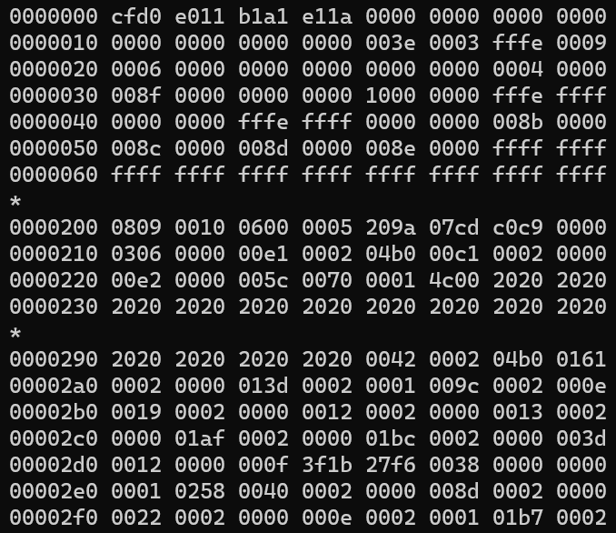
Would you use this data?

Slide 15
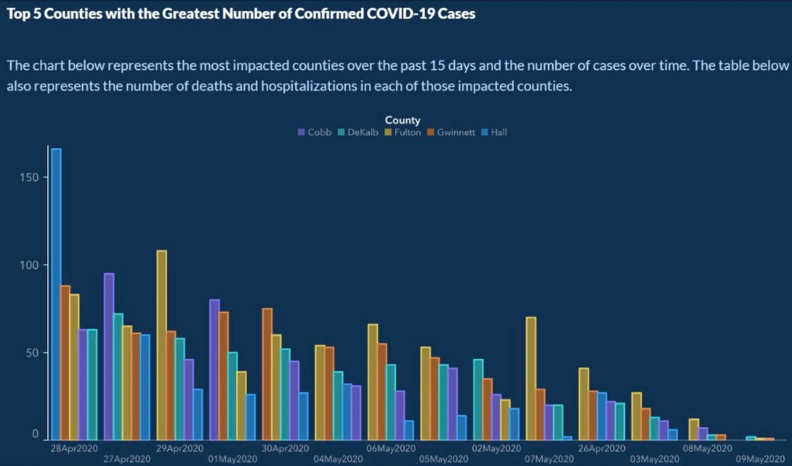
Or would you trust this data?

Slide 16
Provenance!
Does the provider have a good record?
Where do the data come from?
What do we know about the data?
Metadata!

Slide 17
“It’s a file called stockmarket.xlsx”
2101.49
2057.64
2063.11
2077.42
2076.78
0
2068.76
2081.34
2046.68
2051.31
2076.62
2099.60
2108.95
2107.40
2124.29
2126.64
2128.28
2119.21
2114.15
2102.15
2079.65
2067.64
2093.25
2108.57
2108.63
2103.84

Slide 18
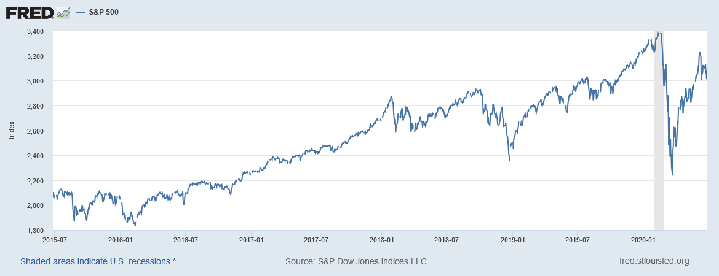
“It’s a file called SP500.xlsx”
SP500 | S&P 500, Index, Daily, Not Seasonally Adjusted
Frequency: Daily, Close
observation_date | SP500
2015-06-26 | 2101.49
2015-06-29 | 2057.64
2015-06-30 | 2063.11
2015-07-01 | 2077.42
2015-07-02 | 2076.78
2015-07-03 | 0
2015-07-06 | 2068.76
2015-07-07 | 2081.34
2015-07-08 | 2046.68
2015-07-09 | 2051.31
2015-07-10 | 2076.62
2015-07-13 | 2099.60
2015-07-14 | 2108.95
2015-07-15 | 2107.40
2015-07-16 | 2124.29
2015-07-17 | 2126.64
2015-07-20 | 2128.28

Slide 19
“It’s a file called SP500.xlsx, downloaded from FRED.”
SP500 | S&P 500, Index, Daily, Not Seasonally Adjusted
Frequency: Daily, Close
observation_date | SP500
2015-06-26 | 2101.49
2015-06-29 | 2057.64
2015-06-30 | 2063.11
2015-07-01 | 2077.42
2015-07-02 | 2076.78
2015-07-03 | 0
2015-07-06 | 2068.76
2015-07-07 | 2081.34
2015-07-08 | 2046.68
2015-07-09 | 2051.31
2015-07-10 | 2076.62
2015-07-13 | 2099.60
2015-07-14 | 2108.95
2015-07-15 | 2107.40
2015-07-16 | 2124.29
2015-07-17 | 2126.64
2015-07-20 | 2128.28

Slide 20
“It’s a file called SP500.xlsx, downloaded from FRED.”
S&P Dow Jones Indices LLC. 2020. “S&P 500 [SP500] [dataset]”, retrieved from FRED, Federal Reserve Bank of St. Louis; https://fred.stlouisfed.org/series/SP500, June 26, 2020.
SP500 | S&P 500, Index, Daily, Not Seasonally Adjusted
Frequency: Daily, Close
observation_date | SP500
2015-06-26 | 2101.49
2015-06-29 | 2057.64
2015-06-30 | 2063.11
2015-07-01 | 2077.42
2015-07-02 | 2076.78
2015-07-03 | 0
2015-07-06 | 2068.76
2015-07-07 | 2081.34
2015-07-08 | 2046.68
2015-07-09 | 2051.31
2015-07-10 | 2076.62
2015-07-13 | 2099.60
2015-07-14 | 2108.95
2015-07-15 | 2107.40
2015-07-16 | 2124.29
2015-07-17 | 2126.64
2015-07-20 | 2128.28

Slide 21
We’re all set then.

Slide 22
“SP500.xlsx, from S&P (2020). Not provided as part of replication package because © S&P. ”
S&P Dow Jones Indices LLC. 2020. “S&P 500 [SP500] [dataset]”, retrieved from FRED, Federal Reserve Bank of St. Louis; https://fred.stlouisfed.org/series/SP500, June 26, 2020.
SP500 | S&P 500, Index, Daily, Not Seasonally Adjusted
Frequency: Daily, Close
observation_date | SP500
2015-06-26 | 2101.49
2015-06-29 | 2057.64
2015-06-30 | 2063.11
2015-07-01 | 2077.42
2015-07-02 | 2076.78
2015-07-03 | 0
2015-07-06 | 2068.76
2015-07-07 | 2081.34
2015-07-08 | 2046.68
2015-07-09 | 2051.31
2015-07-10 | 2076.62
2015-07-13 | 2099.60
2015-07-14 | 2108.95
2015-07-15 | 2107.40
2015-07-16 | 2124.29
2015-07-17 | 2126.64
2015-07-20 | 2128.28

Slide 23
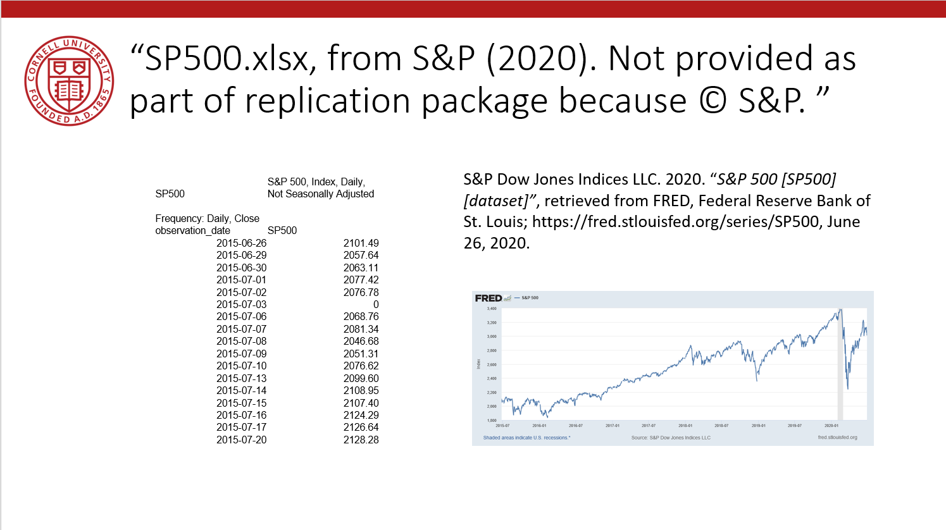
Data Availability Statements
Describes data file, where to get it, how to get it, and any conditions of obtaining it

Slide 24
Data Citation
Attributes the file to the proper source

Slide 25
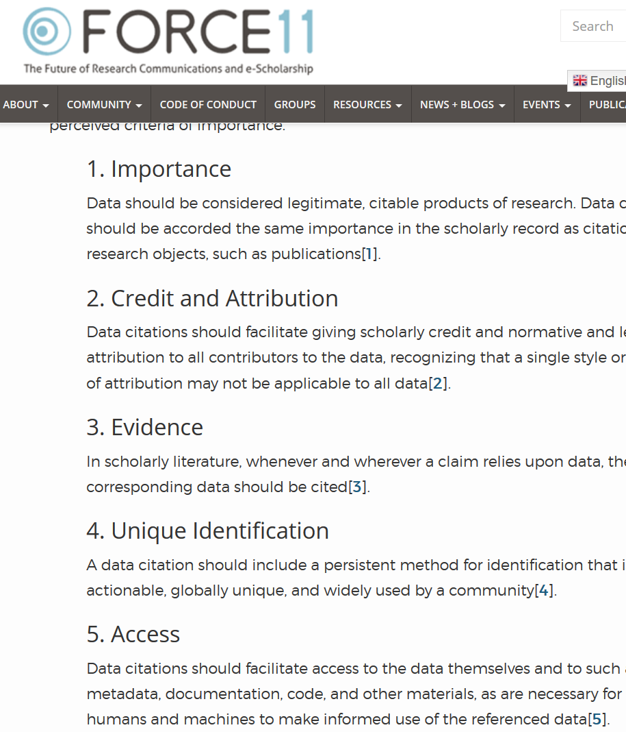

Starts with Data Citations
Data Citation Principles
Image of a standard data citation
Data Citation Synthesis Group: Joint Declaration of Data Citation Principles. Martone M. (ed.) San Diego CA: FORCE11; 2014 [https://www.force11.org/group/joint-declaration-data-citation-principles-final].

Slide 26
Data Citations are Hard!

Slide 27
At the AEA, every manuscript is checked
What datasets are used
Are they cited?
Is there additional information on access?
Is there license/ data use information?
→ Should the author provide the data?
→ Is the author allowed to provide data?

Slide 28
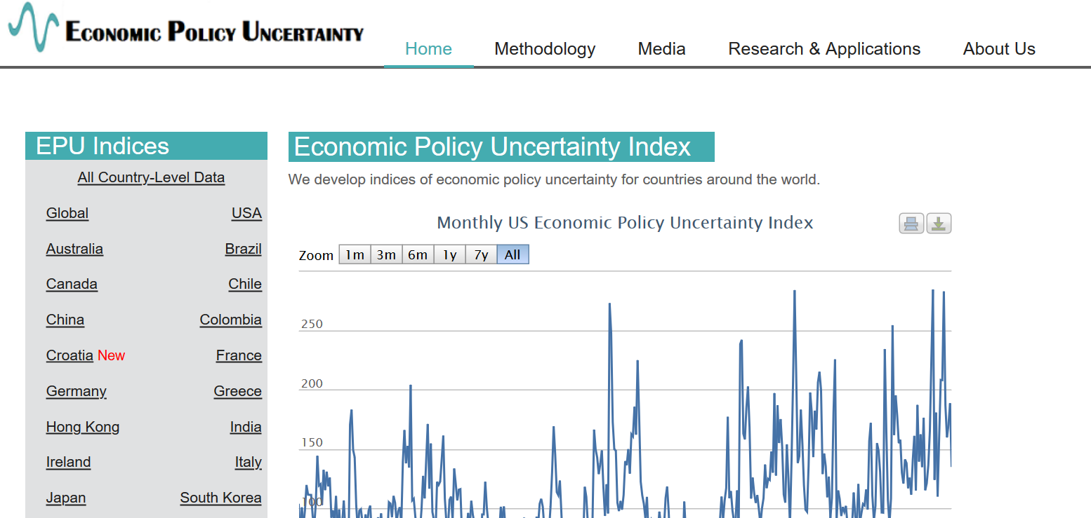
Example 2: Academic data publisher

Slide 29

Example 2: Academic data publisher

Slide 30

Example 2: Academic data publisher-new!

Slide 31
Data Rights

Slide 32
Rights to use data
You browsed a website
You purchased the data
You signed a data use agreement
You created the data (lab experiment)
You had survey respondents consent to use (IRB approval!)

Slide 33
Rights to distribute the data
If you created the data, you decide.
If you got it from somewhere else:
READ THE TERMS OF USE / DATA USE AGREEMENT / CLICK-THROUGH / ETC.

Slide 34
Citing restricted-access data
“Well, I can’t download the data, so I can’t cite it.”

Slide 35
Wrong

Slide 36
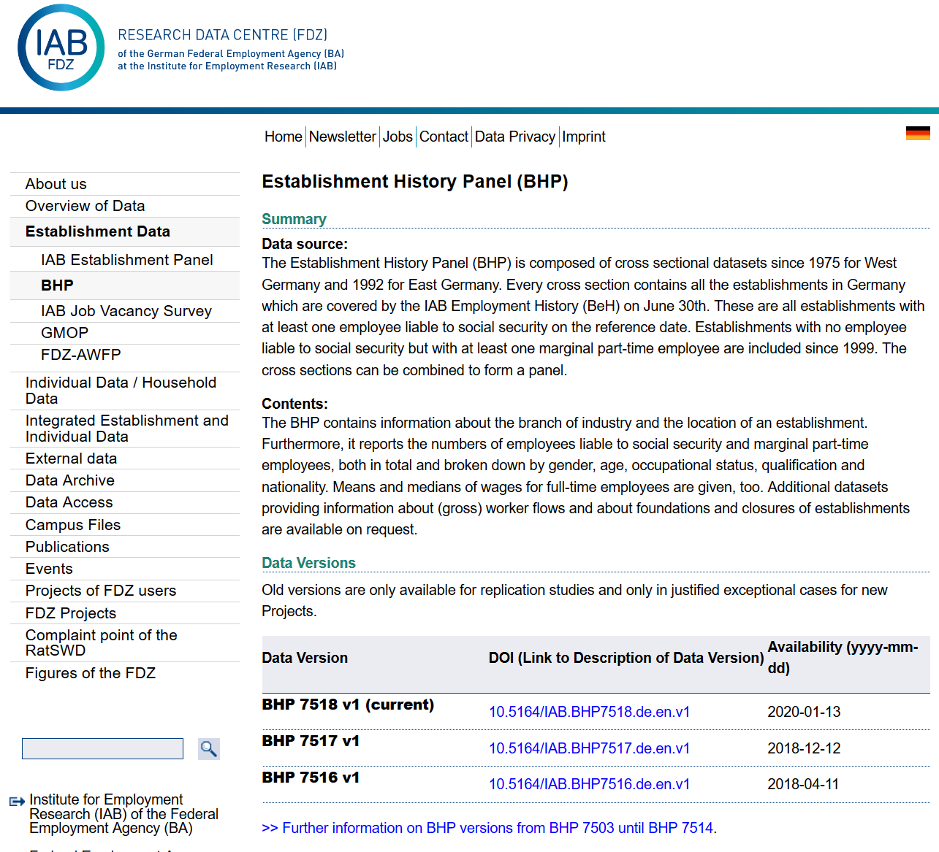
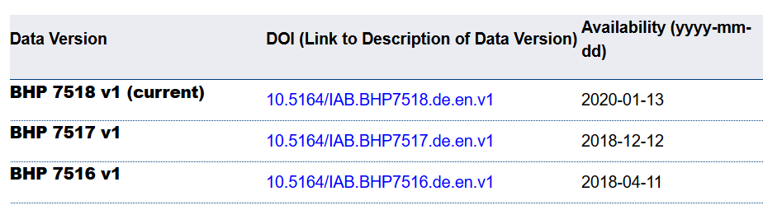
Example 4: German Restricted-access

Slide 37
Example 4: German Restricted-access

Slide 38

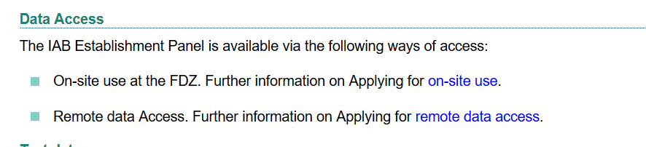
Example 4: German Restricted-access

Slide 39
Element of a (data) citation
CMOS notes (16th ed., 14.1)
“Regardless of the convention being followed, source citations must always provide sufficient information either to lead readers directly to the sources consulted or, for materials that may not be readily available, to enable readers to positively identify them, regardless of whether the sources are published or unpublished or in printed or electronic form.”
ICPSR notes that a citation should include the following items:
Author
Title
Distributor
Date
Version
Persistent identifier

Slide 40
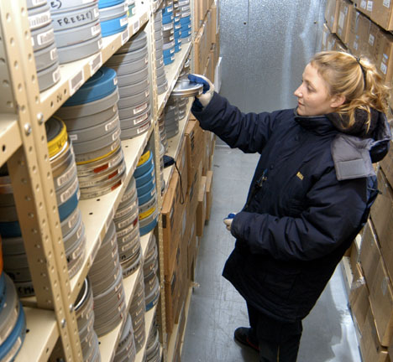
These are archives
Source: https://chiddicksfamilytree.com/2017/11/08/use-it-or-lose-it/
Source: https://www.archives.gov/publications/prologue/2008/spring/frc.html

Slide 41
They are citable
Typescript of short story Brothers and Sisters by Budge Wilson, 2000, MS-2-650.2013-070, Box 3, Folder 9, Budge Wilson fonds, Dalhousie University Archives, Halifax, Nova Scotia, Canada.

Slide 42
Element of a (data) citation
ICPSR notes that a citation should include the following items:
Author
Title
Distributor
Date
Version
Persistent identifier
Suggested Citation:
S&P Dow Jones Indices LLC, S&P 500 [SP500], retrieved from FRED, Federal Reserve Bank of St. Louis; https://fred.stlouisfed.org/series/SP500, June 26, 2020.

Slide 43
Element of a (data) citation
ICPSR notes that a citation should include the following items:
Author
Title
Distributor
Date
Version
Persistent identifier
Constructed Citation:
Institute for Employment Research (IAB), Establishment History Panel 1975-2018. Accessed via the Research Data Centre (FDZ) of the German Federal Employment Agency DOI: 10.5164/IAB.BHP7518.de.en.v1 June 26, 2020.

Slide 44
Element of a (data) citation
ICPSR notes that a citation should include the following items:
Author
Title
Distributor
Date
Version
Persistent identifier
Constructed Citation:
US Census Bureau, Longitudinal Business Database (LBD) 1975-2018. Last accessed via the Federal Statistical Research Data Centre (FSRDC) June 26, 2020.

Slide 45
And we check them!
If the URL does not work, we make a note.
If the site requires registration, we try it out.
How long?
Any requirements?
What does the site say?
Please use the following citation when referring to this file in the different versions: Inglehart, R., C. Haerpfer, A. Moreno, C. Welzel, K. Kizilova, J. Diez-Medrano, M. Lagos, P. Norris, E. Ponarin & B. Puranen et al. (eds.). 2014. World Values Survey: Round Six - Country-Pooled Datafile Version: www.worldvaluessurvey.org/WVSDocumentationWV6.jsp. Madrid: JD Systems Institute.
Is that in the README / Paper/ Appendix?

Slide 46
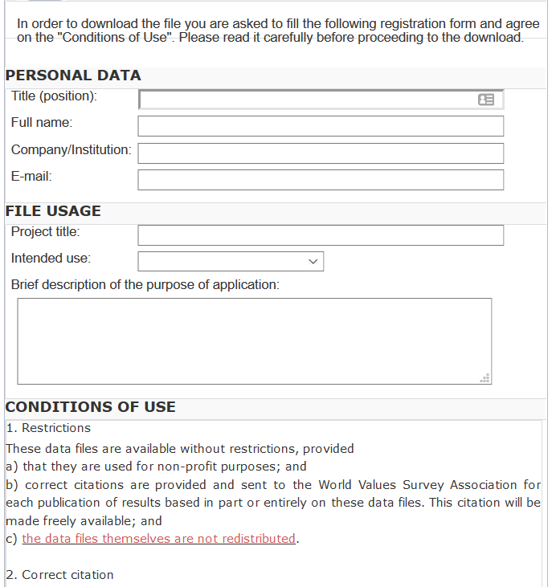
And we check them!
What does the site say?
Please use the following citation when referring to this file in the different versions: Inglehart, R., C. Haerpfer, A. Moreno, C. Welzel, K. Kizilova, J. Diez-Medrano, M. Lagos, P. Norris, E. Ponarin & B. Puranen et al. (eds.). 2014. World Values Survey: Round Six - Country-Pooled Datafile Version: www.worldvaluessurvey.org/WVSDocumentationWV6.jsp. Madrid: JD Systems Institute.
Is that in the README / Paper/ Appendix?
Are all the conditions met/described?

Slide 47
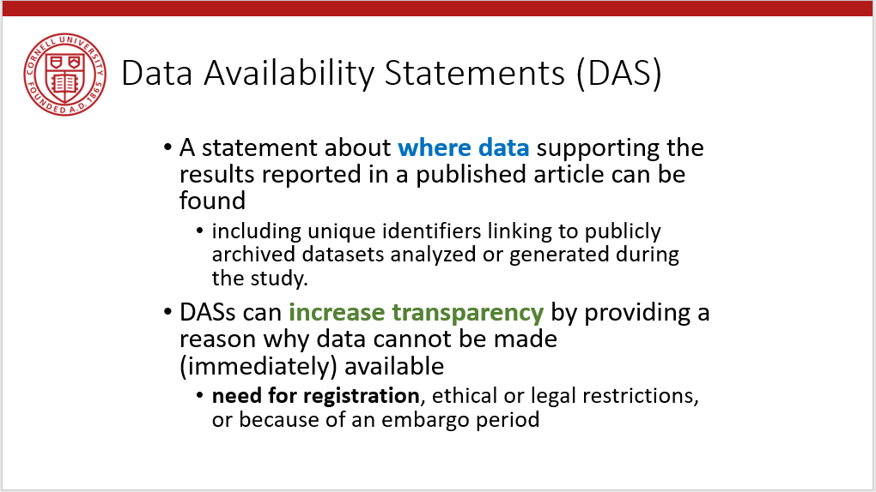
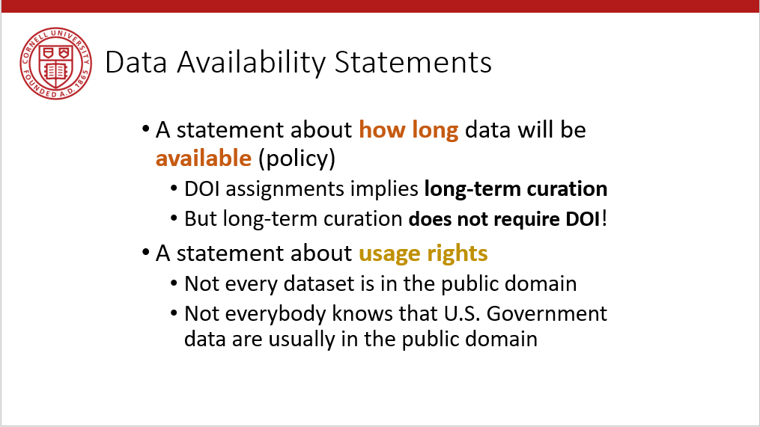
Provide data citations (in manuscript) and data availability statements (in README or appendix)

Slide 48
Take-away

Slide 49
Data: Citations, Access, Rights
Any data can be cited – even if you can’t download it
Any data that you accessed … can have that access be described
But caution: It should be such that others can also repeat the access!
Just because you “have” the data does not mean you can give it to others
Also: distinguish between “sharing” and “publishing”
Know your terms of use!

Slide 50
Documenting

Slide 51
What about your code?

Slide 52
How is your code documented?
For yourself:
What are you doing on lines 30-45?
Will you still remember that in 3 years?
Does it require any instructions outside of the code?
For your audience:
Your thesis advisor
Your boss
Your co-worker, to whom you’ve been trying to hand off this project for two weeks and you’ve finally convinced your boss…

Slide 53
Poor coding practices
Manual/non-automation
Code produces no meaningful output
Lack of robustness:
Bugs in the code

Slide 54
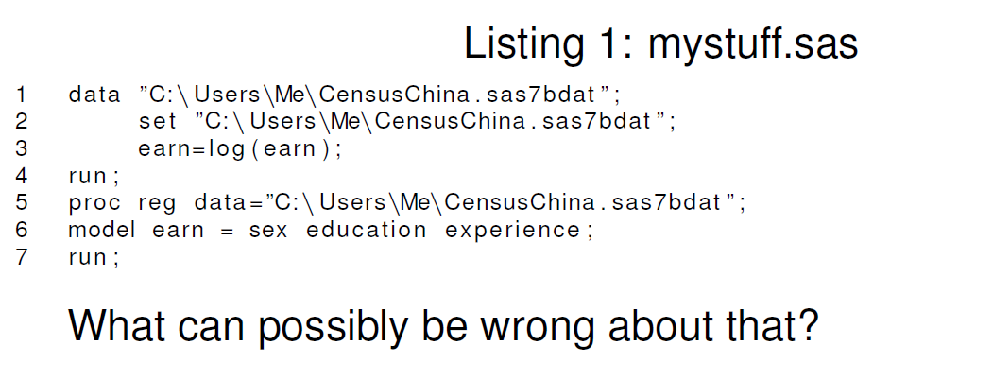
Basic coding hints

Slide 55
What’s wrong with that?
Everything!
Name of program: uninformative
Destruction of original data: program cannot be re-run for same results
No portability: cannot be run anywhere else
No explanation: why are we doing this?

Slide 56
Structuring programs
Portability: should be easy to adjust to a new location
Your new laptop
A replicator 10 years down the road
Clarity: don’t assume that you will remember what seems so obvious now
Describe what you are doing, and why

Slide 57
File structure
mystuff.R
read.R
version2.R
ols.sas
readCensus.R
readBLS.R
prepareCensus.R
runols.sas

Slide 58
Better
01_01_readBLS.R
02_01_readCensus.R
02_02_prepareCensus.R
03_01_createanalysisdata.R
04_01_runOLS.sas
README.txt

Slide 59
Functions
Create re-usable code
… for other projects
… within the same project (robustness checks, variation on regressions, etc.)
Feasible in any programming language
Stata: “program” or ado files
SAS: macros
R: functions or packages

Slide 60

Streamlining replication packages
Master script preferred
Least amount of manual effort
No manual manipulation
“Change the parameter to 0.2, then run the code again”
No manual copying of results
Write out/save tables and figures using packages
Compute all numbers in package
No manual install of packages
Use a script to create all directories, install all necessary packages/requirements/etc.
Clear instructions!

Slide 61
Two magic Stata lines
global basepath “/my/path/here”
adopath + “$basepath/ado”
In addition to “graph export”, “outtab”, etc.

Slide 62
Extreme examples
Matlab-based simulation
Real example, 10 figures, 4 panels each
For Figure 5a, comment line 52, uncomment line 151, run the code, then copy the figure into your document.
For Figure 5b, comment line 151 again, leave line 52 commented, and change the parameter on line 75 to “3”
….

Slide 63
Extreme examples
Stata-based estimation
4 variants
Run the data creation programs, then copy the data to Folder A
Copy programs “b.do” and “c.do” from Folder A to Folder B, but modify “c.do” on line 20
Once done, convert the output from “d.do” to a Matlab file, and run the simulation in Folder B/C
….

Slide 64
Ideal setup
1 program to prepare the setup
Installs all packages
Creates all directories
1 program (or a very small number) that creates the rest
Possibly with macros/ ado files/ subroutines
Possibly with parameter files that might differ per directory
All tables and figures are output programmatically
Setting up can be done in all languages
Matlab, Stata, R, Python, Fortran
Subroutines exist in all languages
You might need to learn how!
Ability to output figures and tables (Excel, LaTeX) exist in all languages

Slide 65
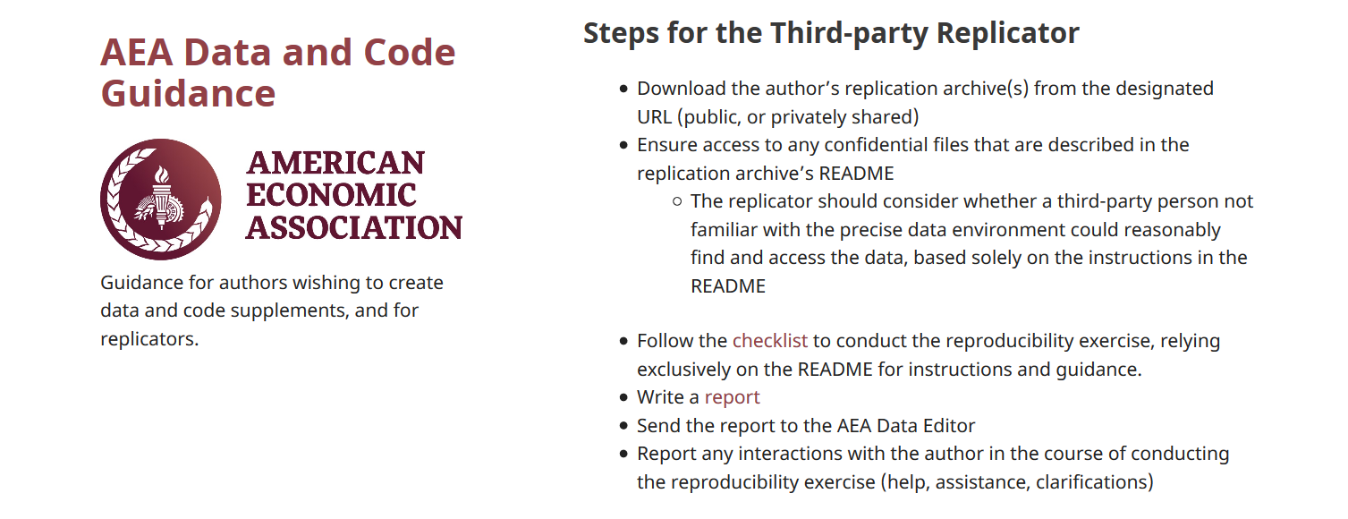
How to prepare the replication package
README
Full package of all programs, data you intend to provide
ZIP it up
Now ask an RA/ colleague/ friend/ grandma/ daughter not previously involved to
Download the package
Follow the instructions in the README without talking to you!
Compare the results to the paper
That’s our Protocol!

Slide 66
Archiving

Slide 67
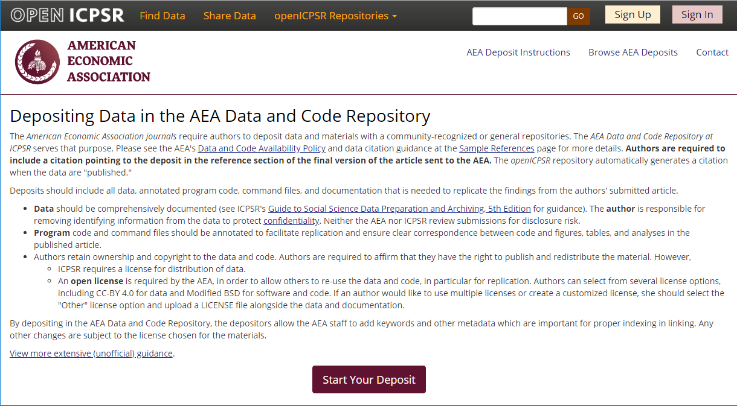
Full-featured repository

Slide 68

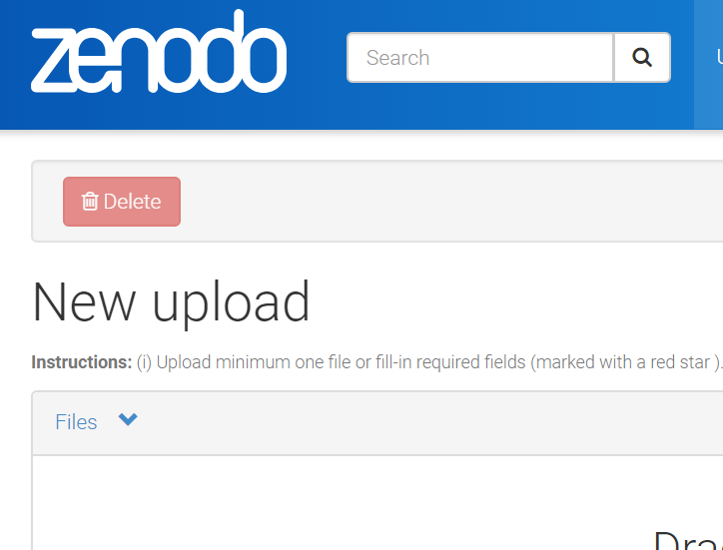
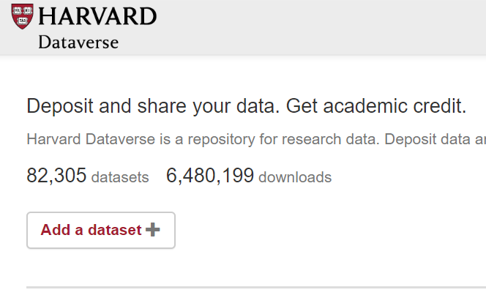
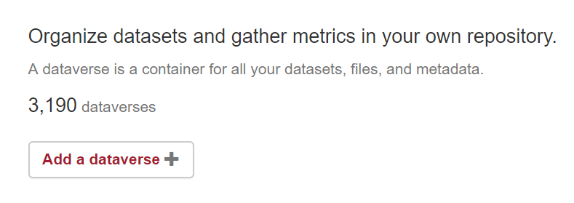
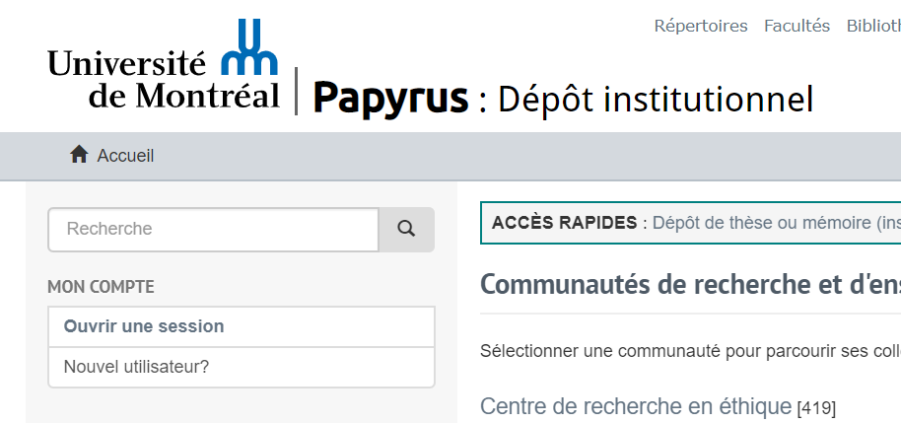


Slide 69
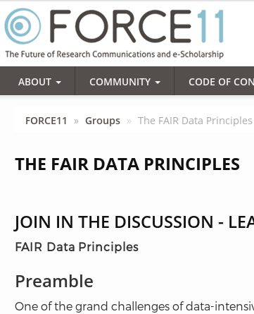
Action: Data citations and metadata
What is FAIR?
Findable,
Accessible,
Interoperable, and
Re-usable

Slide 70
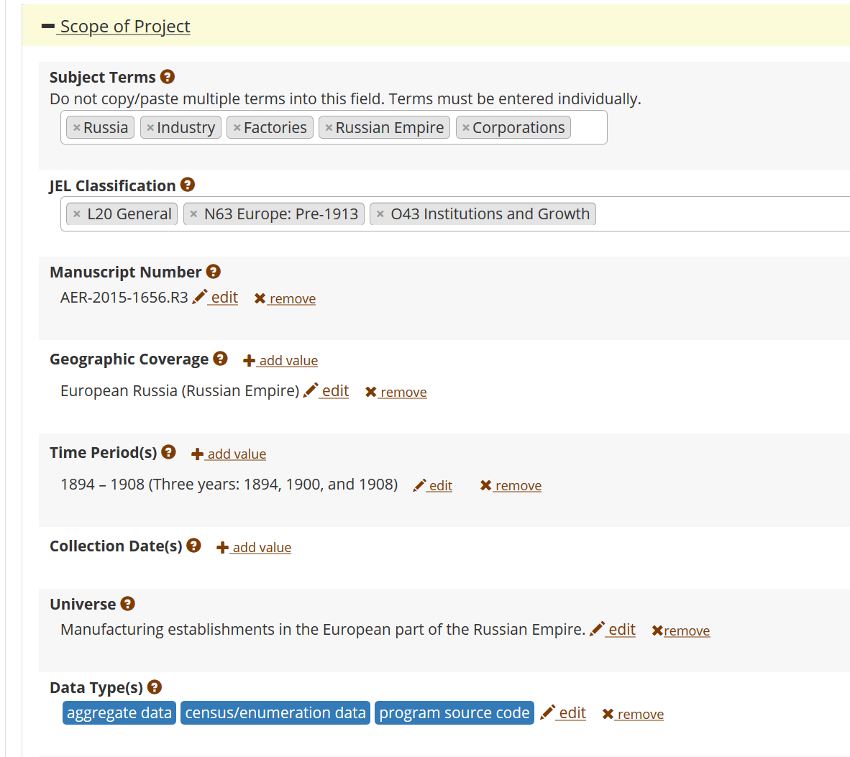
FAIR data principles rely on metadata
Notes:
Show metadata for this page

Slide 71
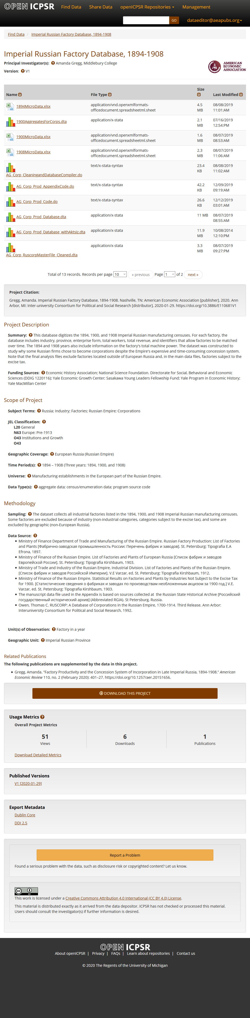
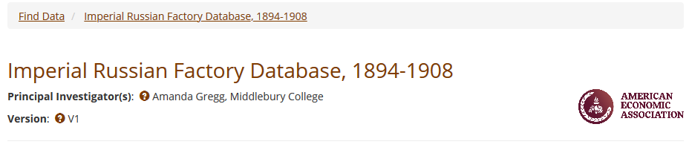
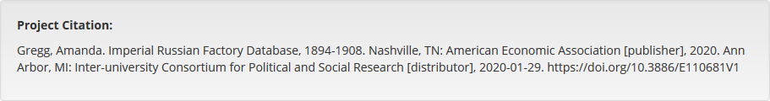
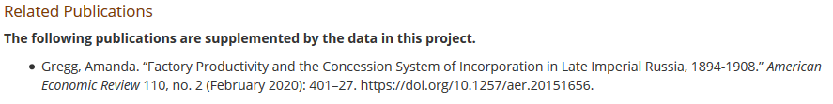

Slide 72
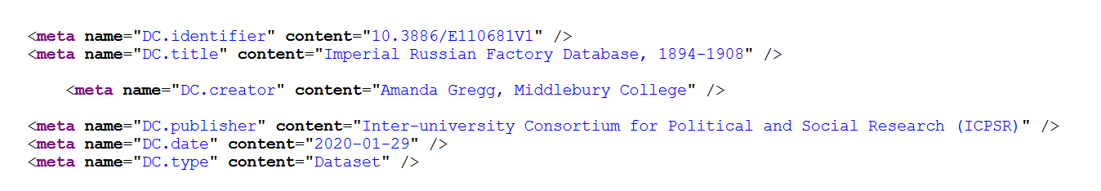

Slide 73
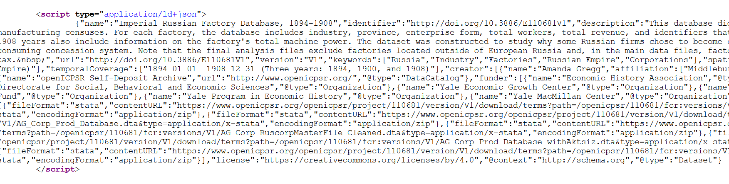

Slide 74
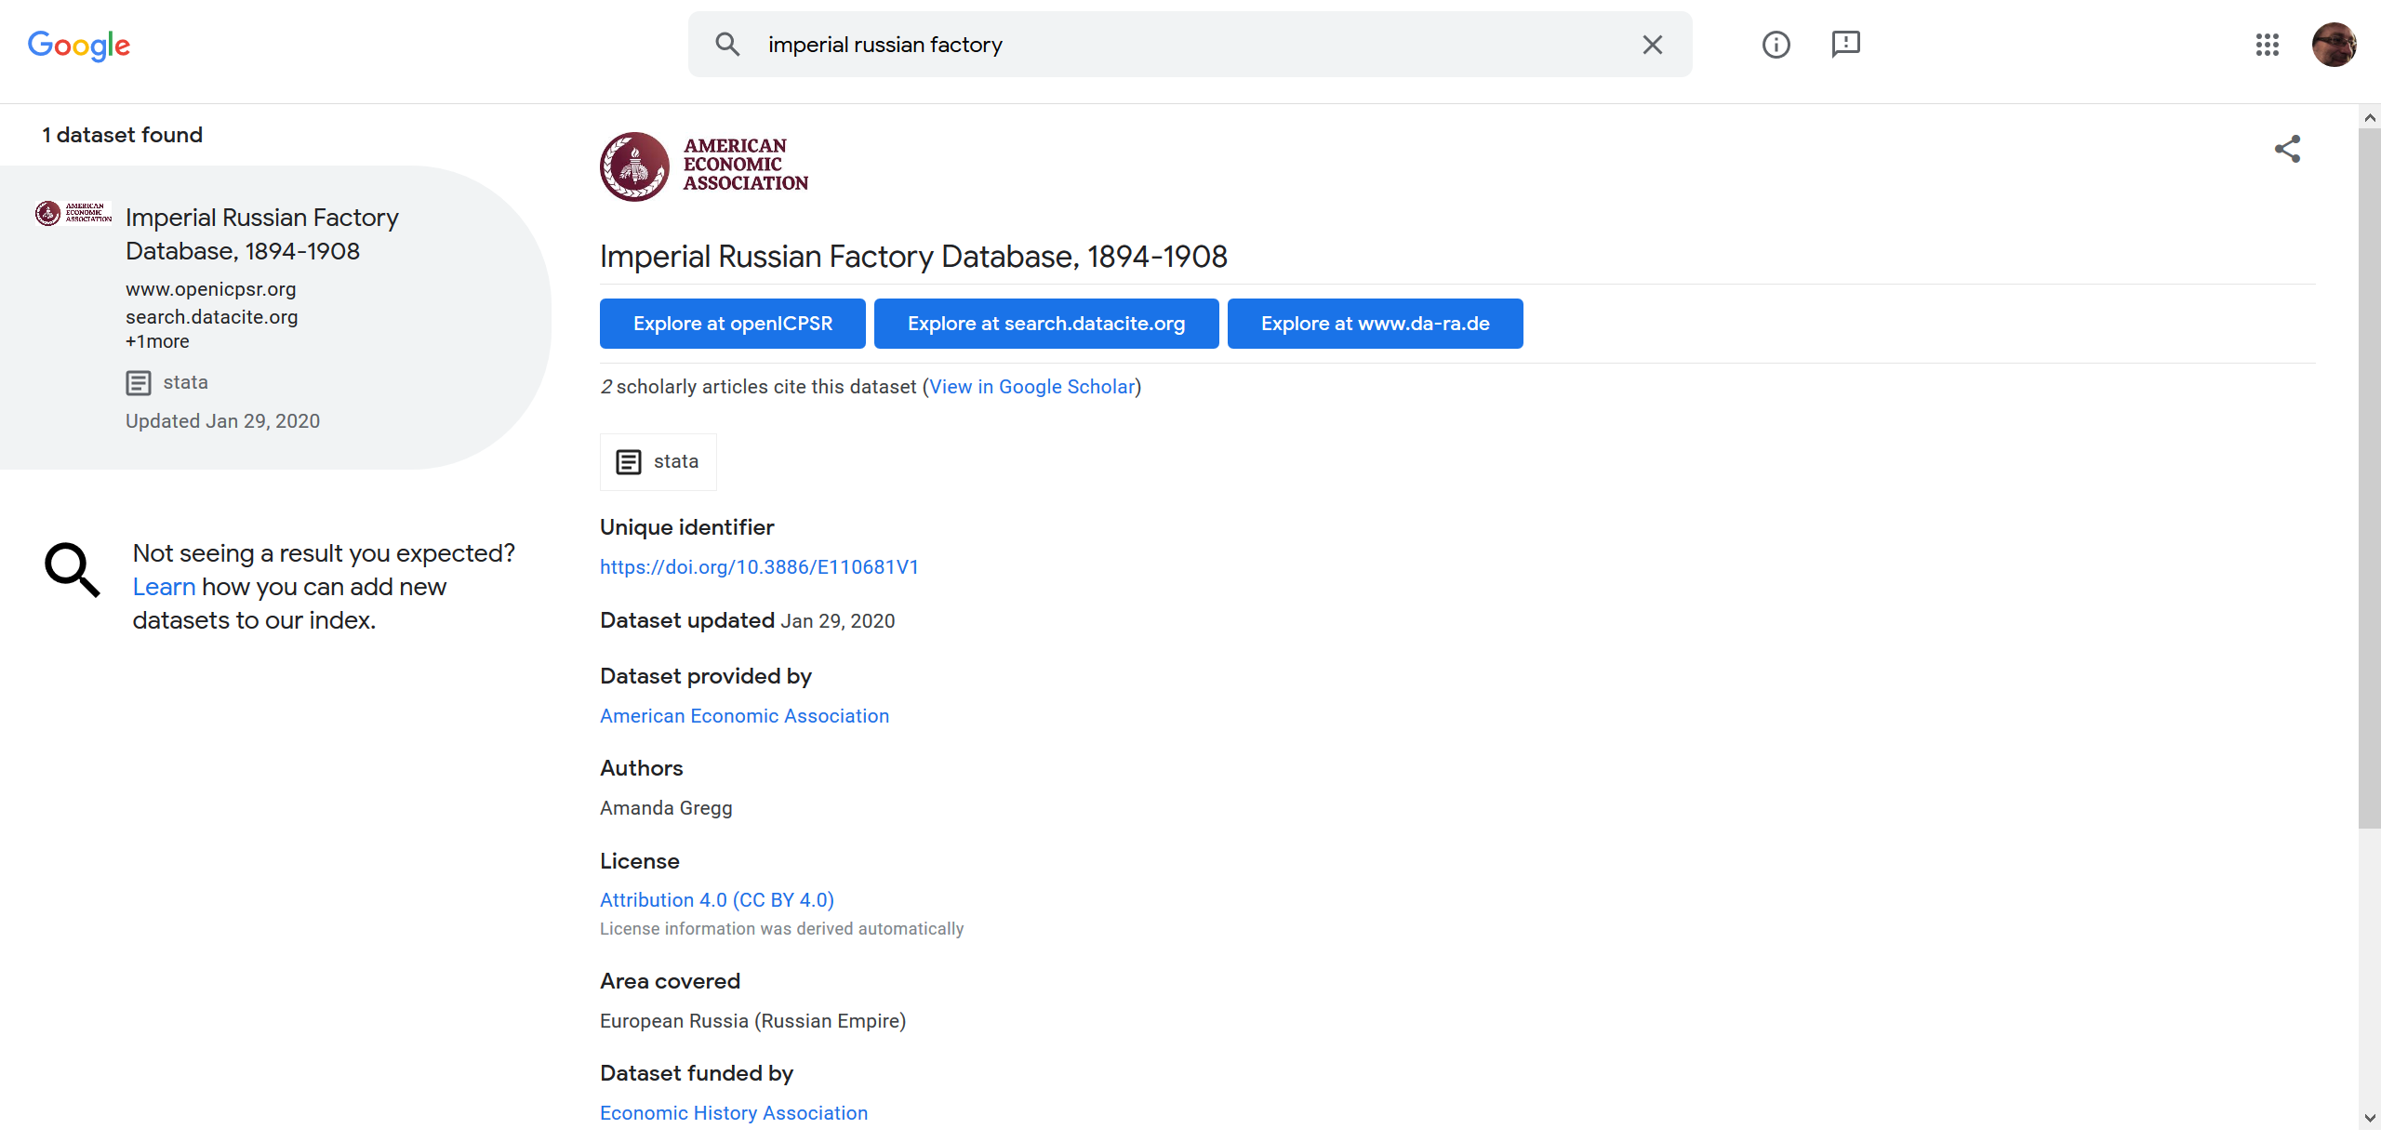
… and findability relies on metadata

Slide 75
But I’ve already got it on Github!
Good for you!

Slide 76
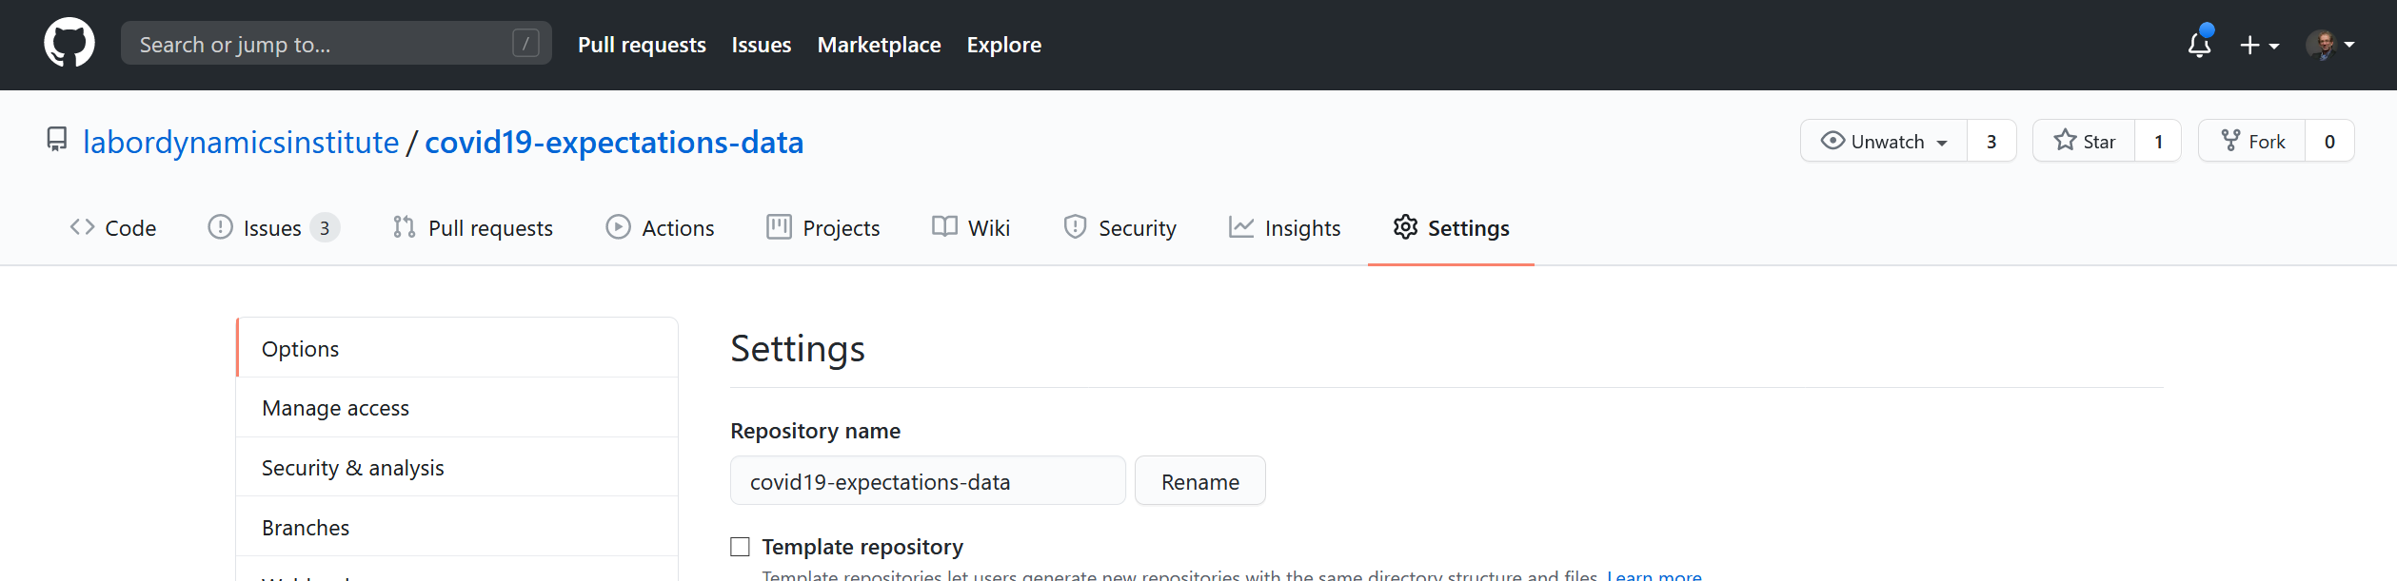
Scroll down a bit

Slide 77
What is not an archive
Github
Dropbox
Your university website
Your personal website on Google Pages
…

Slide 78
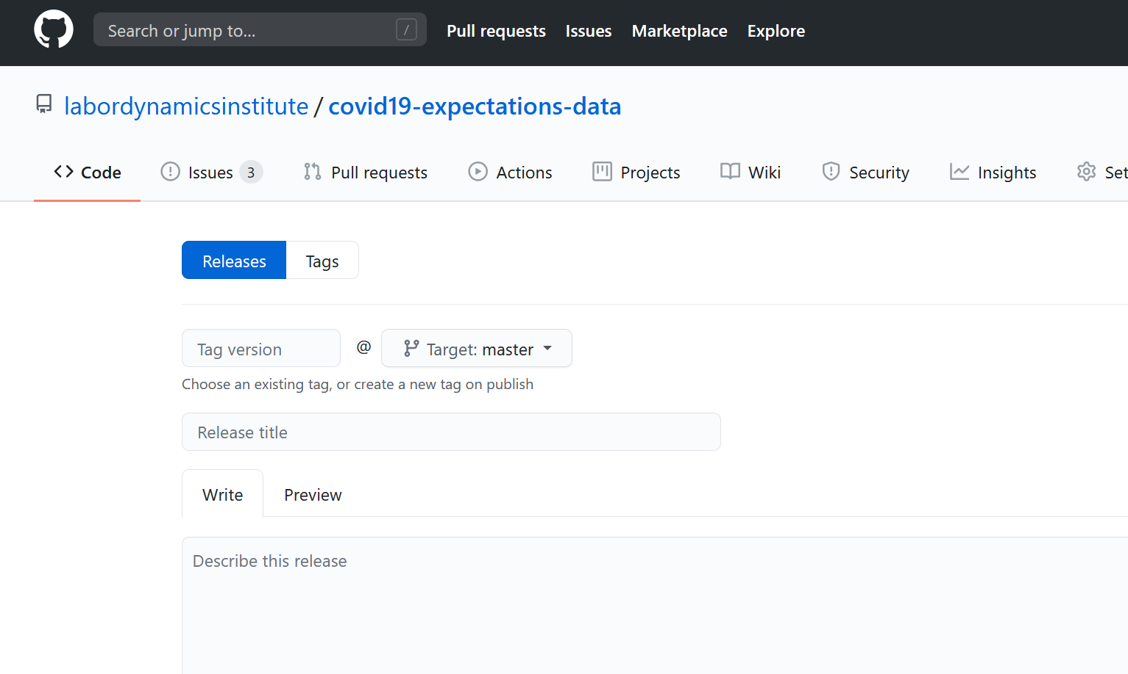
And: releases!

Slide 79
Suggestions
Use releases as part of your development process
Define critical moments
Showing it to your thesis advisor
Submitting to a journal
Submitting the R&R
Submitting the 5th R&R
Responding to the Data Editor
Hit that “Create release” button
Or “git tag –m “my msg” v20200924”
Learn how to archive
openICPSR sandbox
Zenodo sandbox
Github-to-Zenodo API
Archive key (public) moments
Submitting to a journal (may be required!)
Presenting at RT2!

Slide 80
Special Cases

Slide 81
You run your own survey
Welcome, you are a data producer, = Census Bureau!
Your questionnaires, your instructions (to self, to survey takers), your sampling scheme: metadata, part of the replication package
Your raw survey data: untouched, archived (but internally: PII!)
Your survey prep code: stripping identifiers, quasi-identifiers: archived, (mostly) public

Slide 82
You run your own survey
Welcome, you are a data provider, even for yourself!
Your (protected, shareable) survey data:
Archived, public (subject to consent)
Provided with license
Immutable! Dirty! As-Is!
You, as anybody else, treats it as “Source”
Cited!
All cleaning happens as part of your replication package!

Slide 83
You run an lab experiment
Welcome, you are a data producer, = Census Bureau!
Etc. etc. etc….
You provide the “programming for the experiment” (zTree, etc.) == survey instrument

Slide 84
You work in an RDC
RDC in the sense: restricted-access data environment
You do not control the environment (storage, backups, etc.)
You cannot just remove artifacts (data, programs)

Slide 85
You work in an RDC
Make your own “github”!
Set aside an area of your workspace for “immutable” copies
Create “releases” as you request removal of data and code
Mirror those “releases” on the outside (at Github, ec.)

Slide 86
You work in an RDC
Document access process
How you got access in the first place
How somebody else could get access today
That might not be the same!
You might not know about it – inform yourself!
How somebody can get access to the files that you cannot remove

Slide 87

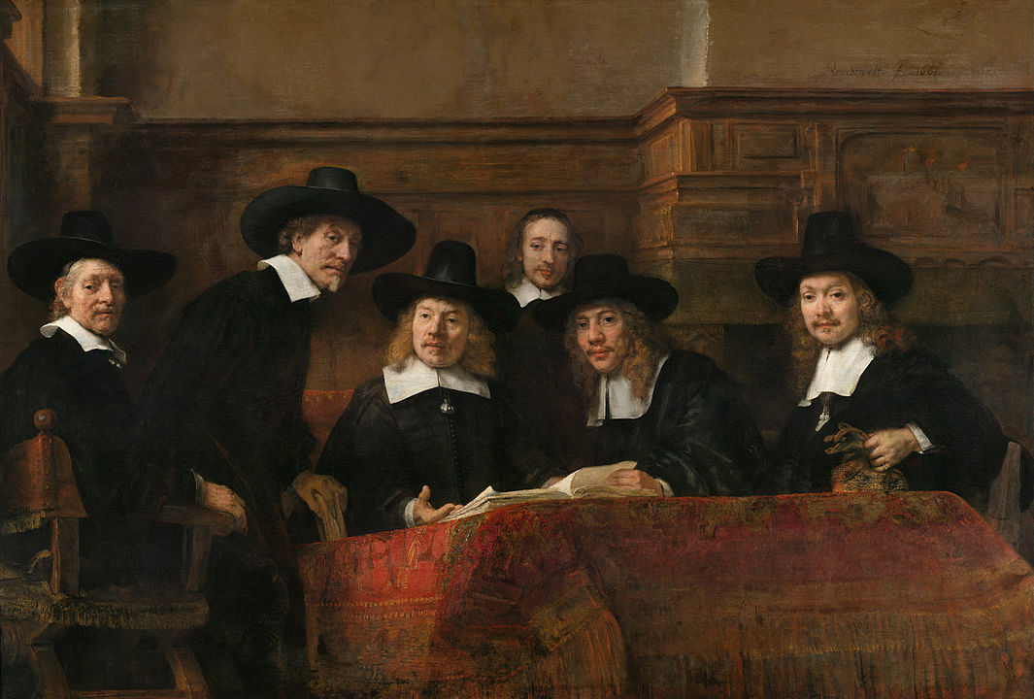
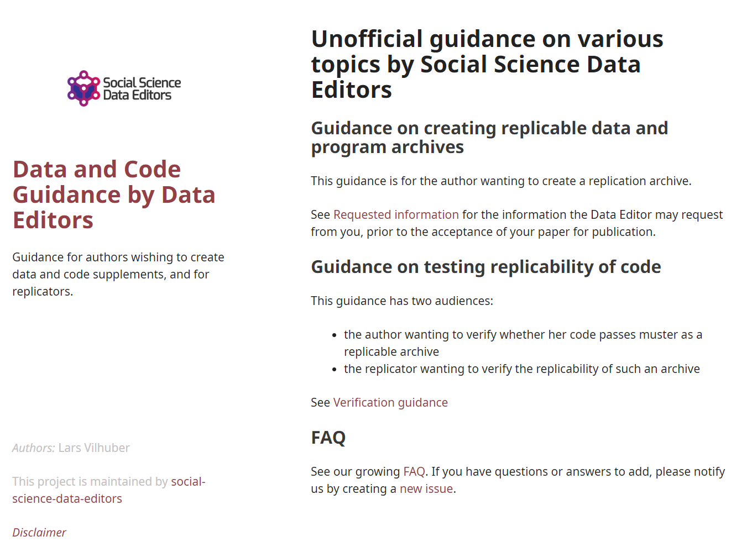
Social science “guild”
https:// social-science -data-editors. github.io/ guidance/

Slide 88
Thank you!
https://doi.org/10.5281/zenodo.4048572

Slide 89

Some resources
https://social-science-data-editors.github.io/guidance/
https://aeadataeditor.github.io/aea-de-guidance/
template README
discussion of licensing
data citation guidance
German example:
Establishment History Panel (BHP) DOI: 10.5164/IAB.BHP7516.de.en.v1

Slide 90
Addendum – just in…

Slide 91

Robust Science and Open Data
https://twitter.com/larsvil/status/1309141822518812676

Slide 92
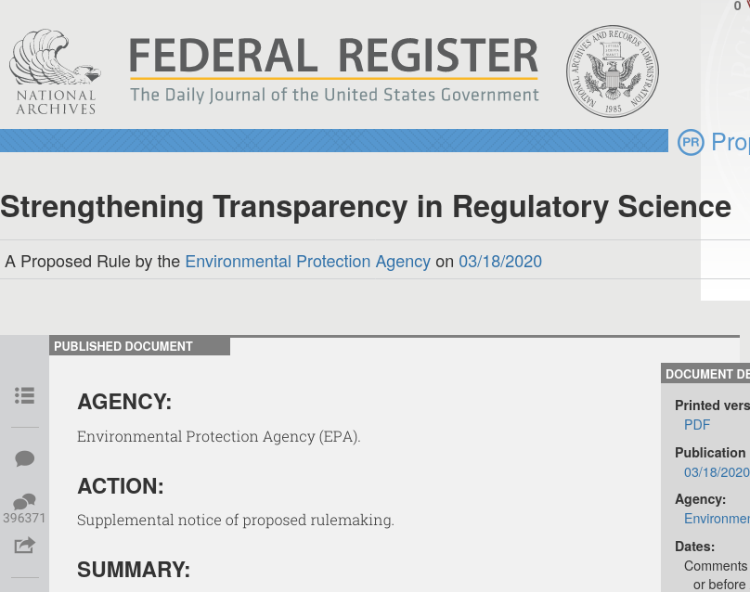
What is at issue?
EPA wants to limit what scientific studies can be taken into consideration when determining rules/policy/etc.
Only Open Access data would count

Slide 93
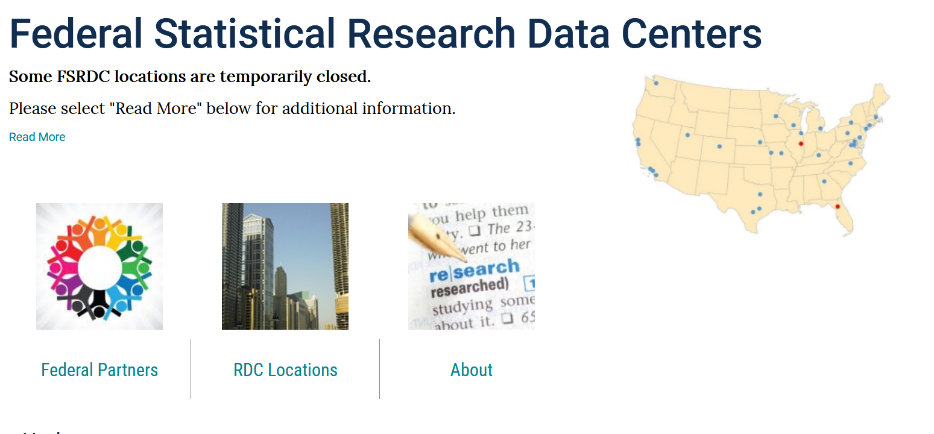
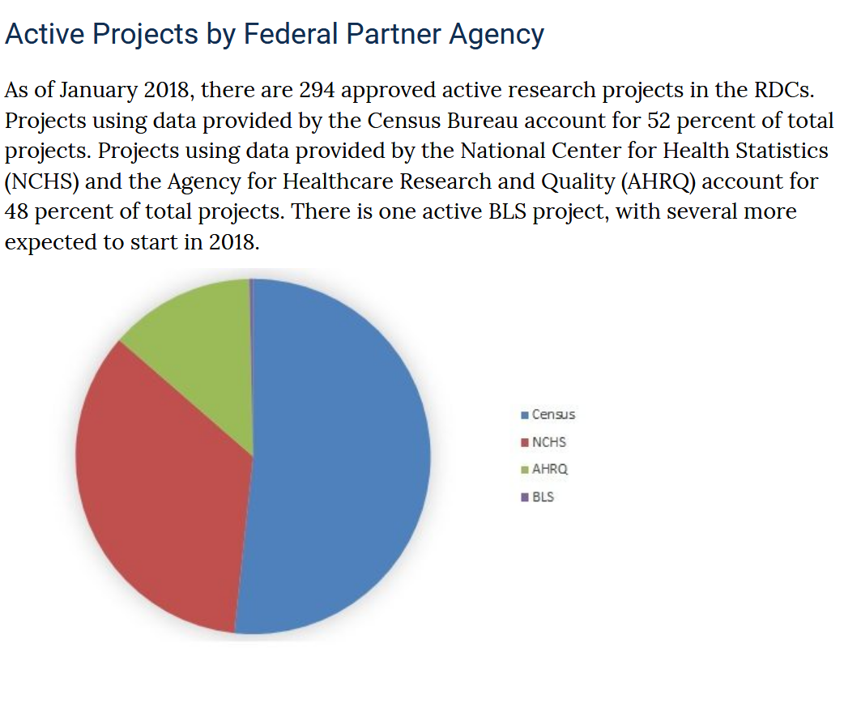
But: that’s not the criterion for robust science
A prime example is the government’s own Federal Statistical Research Data Center (FSRDC) system, where confidential data from five agencies (health, taxes, wages, etc.), is used at any time by several hundred researchers, on hundreds of approved projects

Slide 94

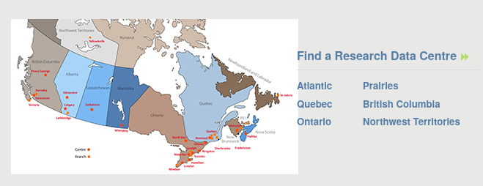
True worldwide
Canada
France
UK
Scandinavia
Germany
….

Slide 95

It is possible to do robust, reproducible, replicable, open, ethical science with restricted-access data
https://twitter.com/larsvil/status/1309141822518812676

